Slide 1
Star Wars Star Trek Education

Slide 2
Star Wars Survey Data
Questions Considered for Analysis
Are you a Star Wars Fan?
Are you a Star Trek fan?
What is your education level?
Source: - https://github.com/fivethirtyeight/data/tree/master/star-wars-survey

Slide 3
The Question? Is there a correlation between Education level and being a Star Trek Fan?

Slide 4
Hypothesis There is a direct correlation between Education level and being a star trek fan irrespective of being a star wars fan Null Hypothesis There is no direct correlation between education level and being a star trek fan

Slide 5
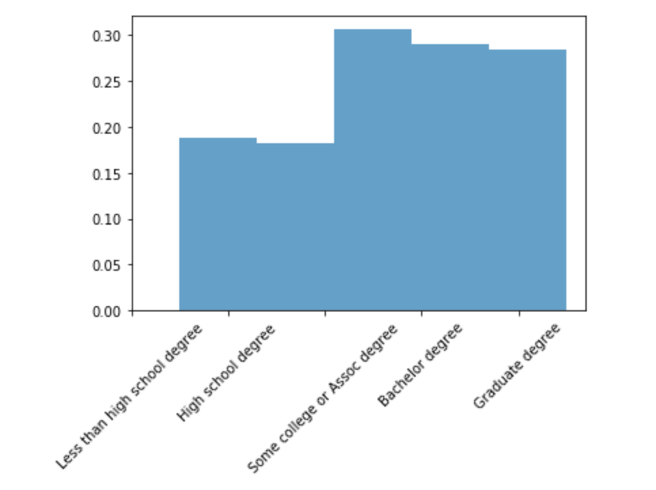
Star Trek Fans By Education Level

Slide 6
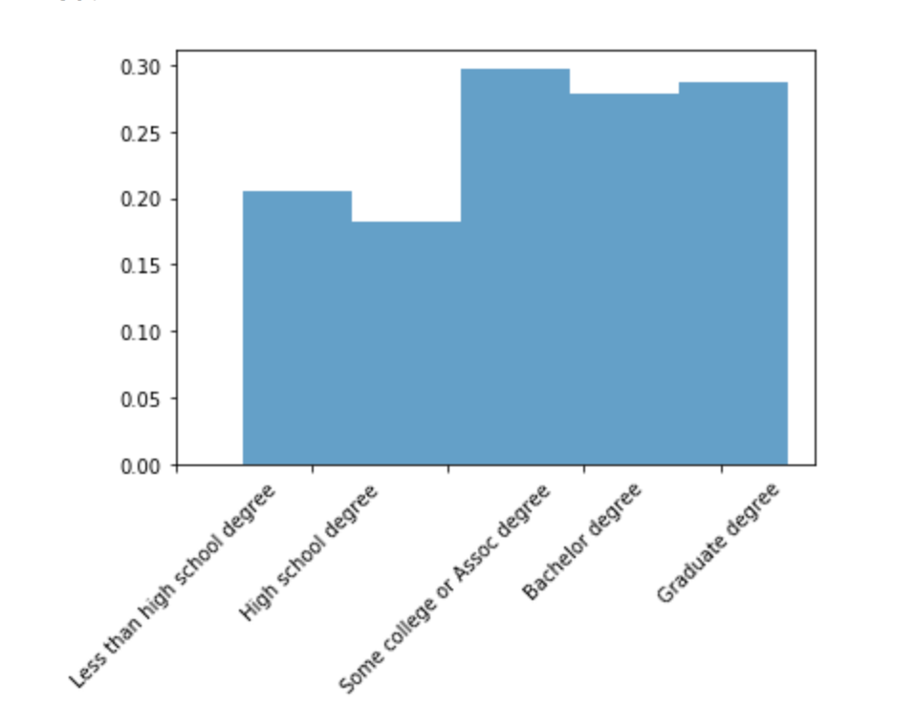
Star Trek fans who are also Star wars fans by education level

Slide 7
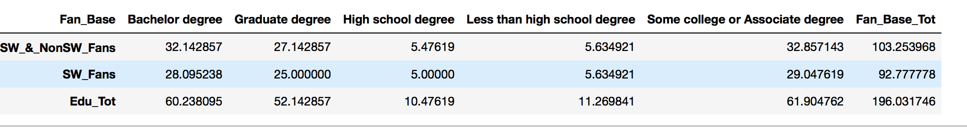
Contingency table to calculate correct, Expected distribution for Chi Square test between two observation distributions.

Slide 8
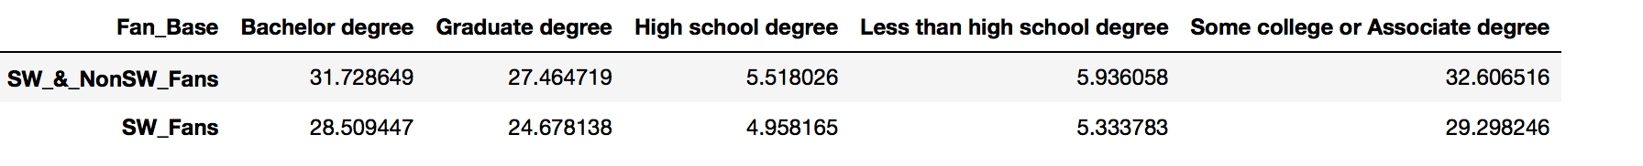
Expected Values table based on Contingency table
Create a Contingency table to caclulate correct, Expected distribution for Chi Square test between two
# observation distributions.
Create a Contingency table to caclulate correct, Expected distribution for Chi Square test between two
# observation distributions.

Slide 9
Conclusions
Chi Square Critical Value: 9.487729036781154
The Chi Square Statistic for Star Trek fans: 0.026699679229070898
The P-value for Star Star Trek fans: 0.9999116799965521
The Chi Square Statistic for Star Wars fans who are Star Trek fans: 0.029714527525253543
The P-Value for Star Wars fans who are Star Trek fans: 0.9998907179791081
The total Chi Square Statistic: 0.026699679229070898 + 0.029714527525253543 = 0.056414206754324445
The total Chi Square Statistic of 0.056414206754324445 is less than our Critical value of 9.487729036781154.
Thus, the difference between our two distributions is not significant.
The total P-Value Statistic: 0.9999116799965521 x 0.9998907179791081 = 0.9998024076274487
The total Chi Square Statistic of 0.9998024076274487 is far greater than our significance P-Value of '.05’.
Thus, the difference between our two distributions is not significant.

Slide 10
The final word
We accept our Null Hypothesis

